Slide 1
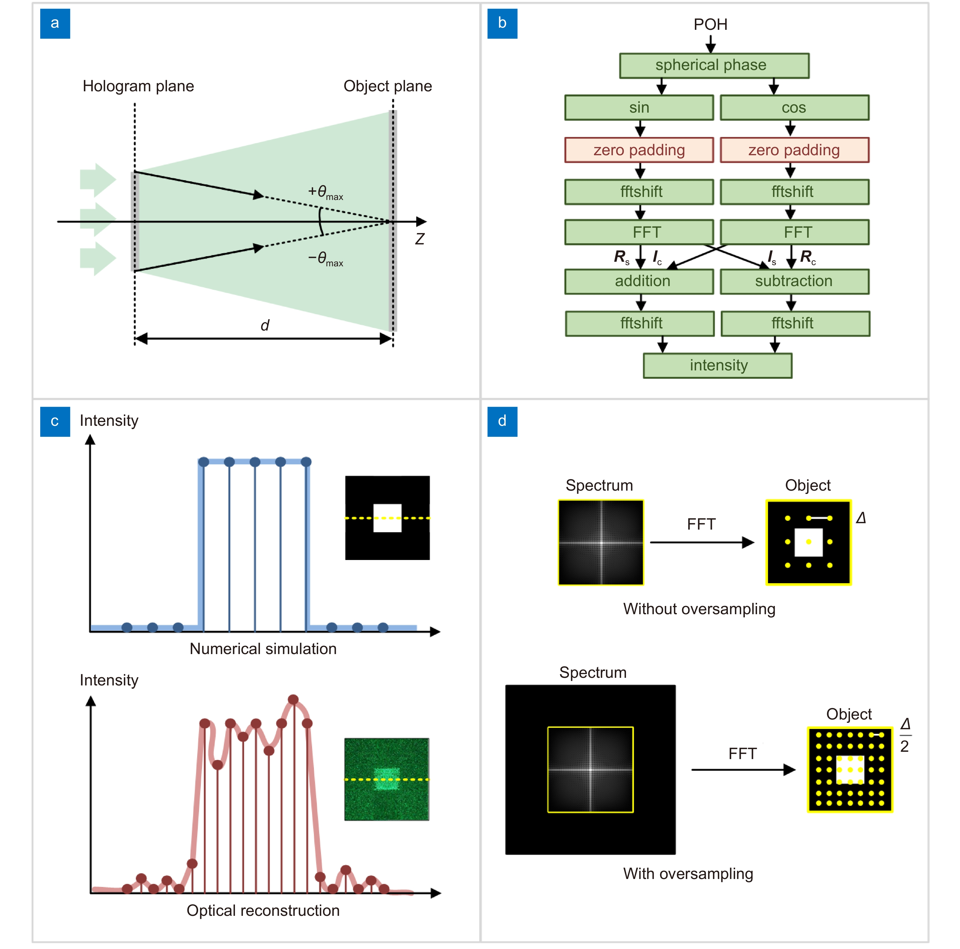
Figure 5. (a) Schematic diagram of the Fresnel diffraction model. (b) Fresnel diffraction model with oversampling method realized in the neural network layer manner. (c) Comparison between the numerical simulation and optical reconstruction with the undersampling problem. (d) Schematic diagram of the oversampling method.
Kexuan Liu,Jiachen Wu,Zehao He,Liangcai Cao
4K-DMDNet: diffraction model-driven network for 4K computer-generated holography
https://doi.org/10.29026/oea.2023.220135

